Slide 1
Wednesday
1
25.03.2020

Slide 2
1. Complete.
Hello! ……………………………..
…………………………………. ? I’m Lisa.
…………………………………. ? I’m OK, Thanks.
Bye-bye! ……………………………………….

Slide 3
2. Find out all the numbers.
TWELVESIXTEENTWENTYNINEEIGHTEENELEVENTHIRTEENTHREEFIFTEENFOUR
Ex . twelve

Slide 4
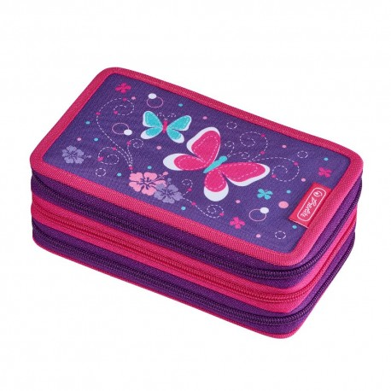
3. Name the objects.
1.

Slide 5
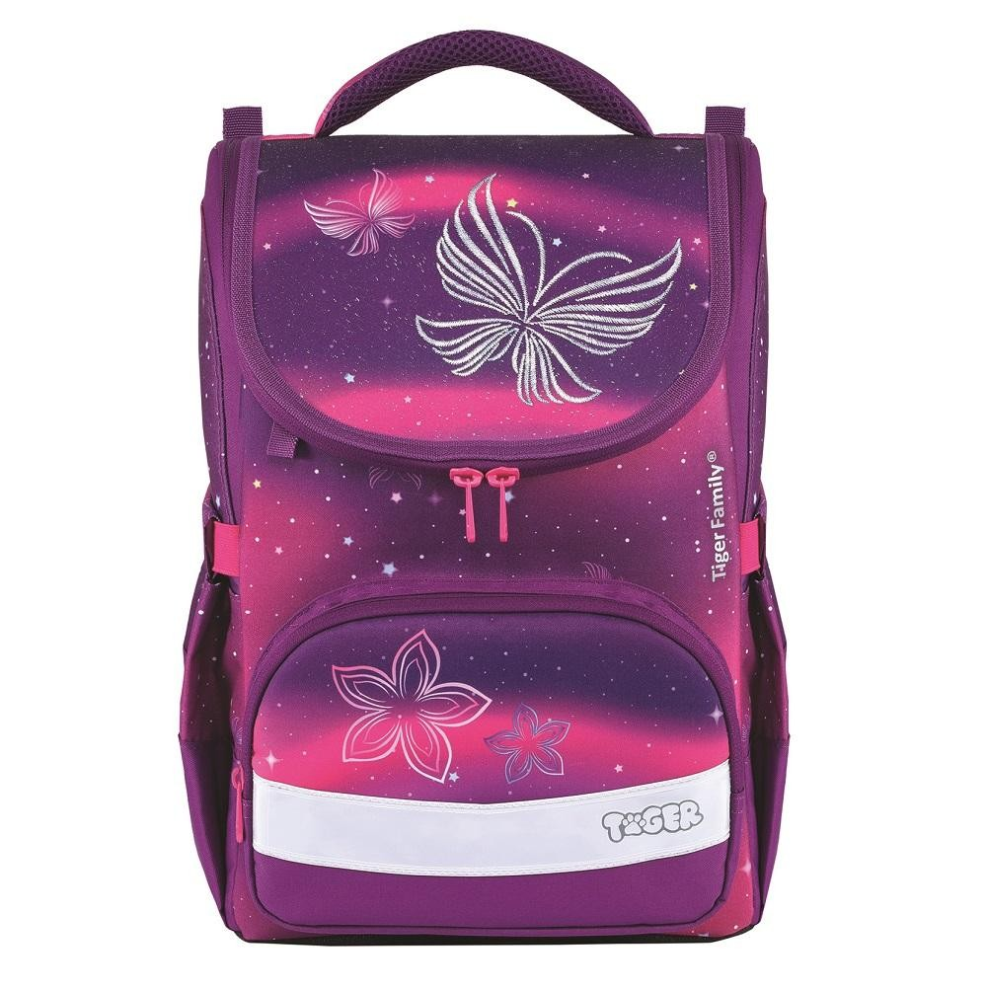
2.

Slide 6
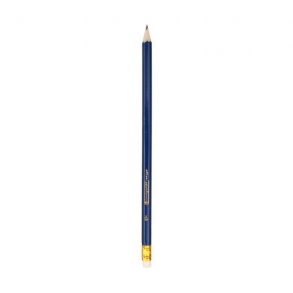
3.

Slide 7
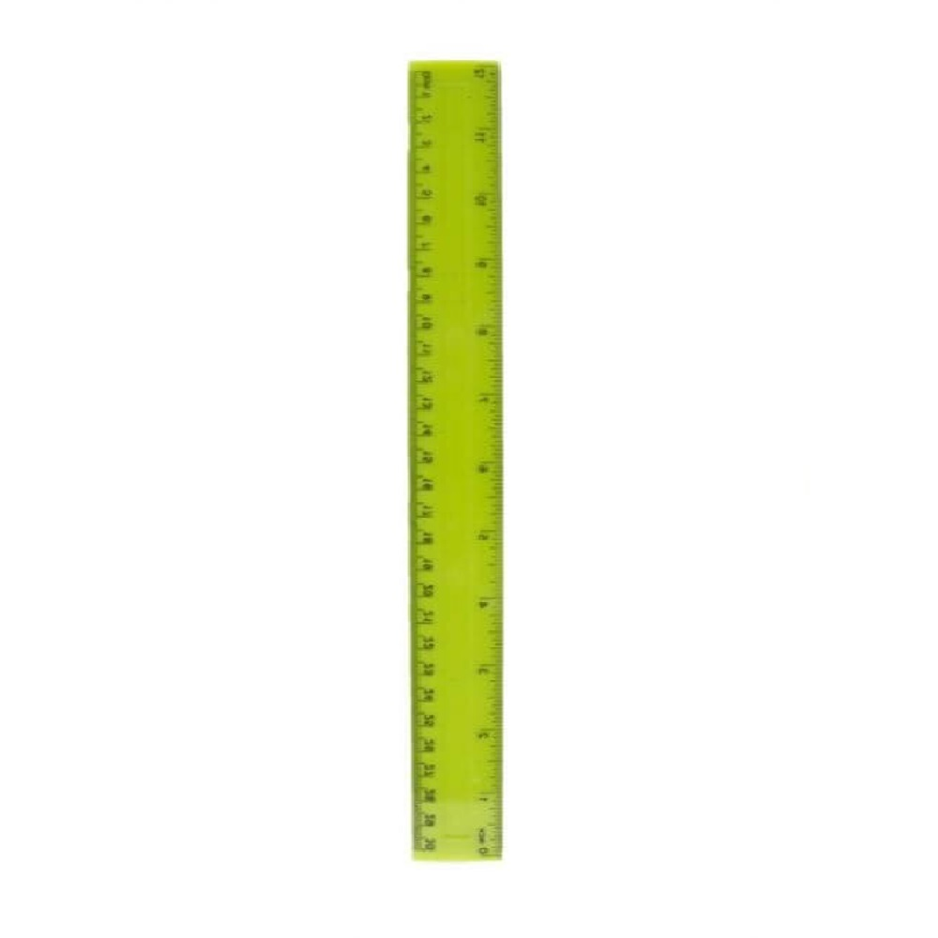
4.

Slide 8
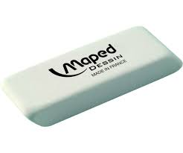
5.

Slide 9

6.

Slide 10
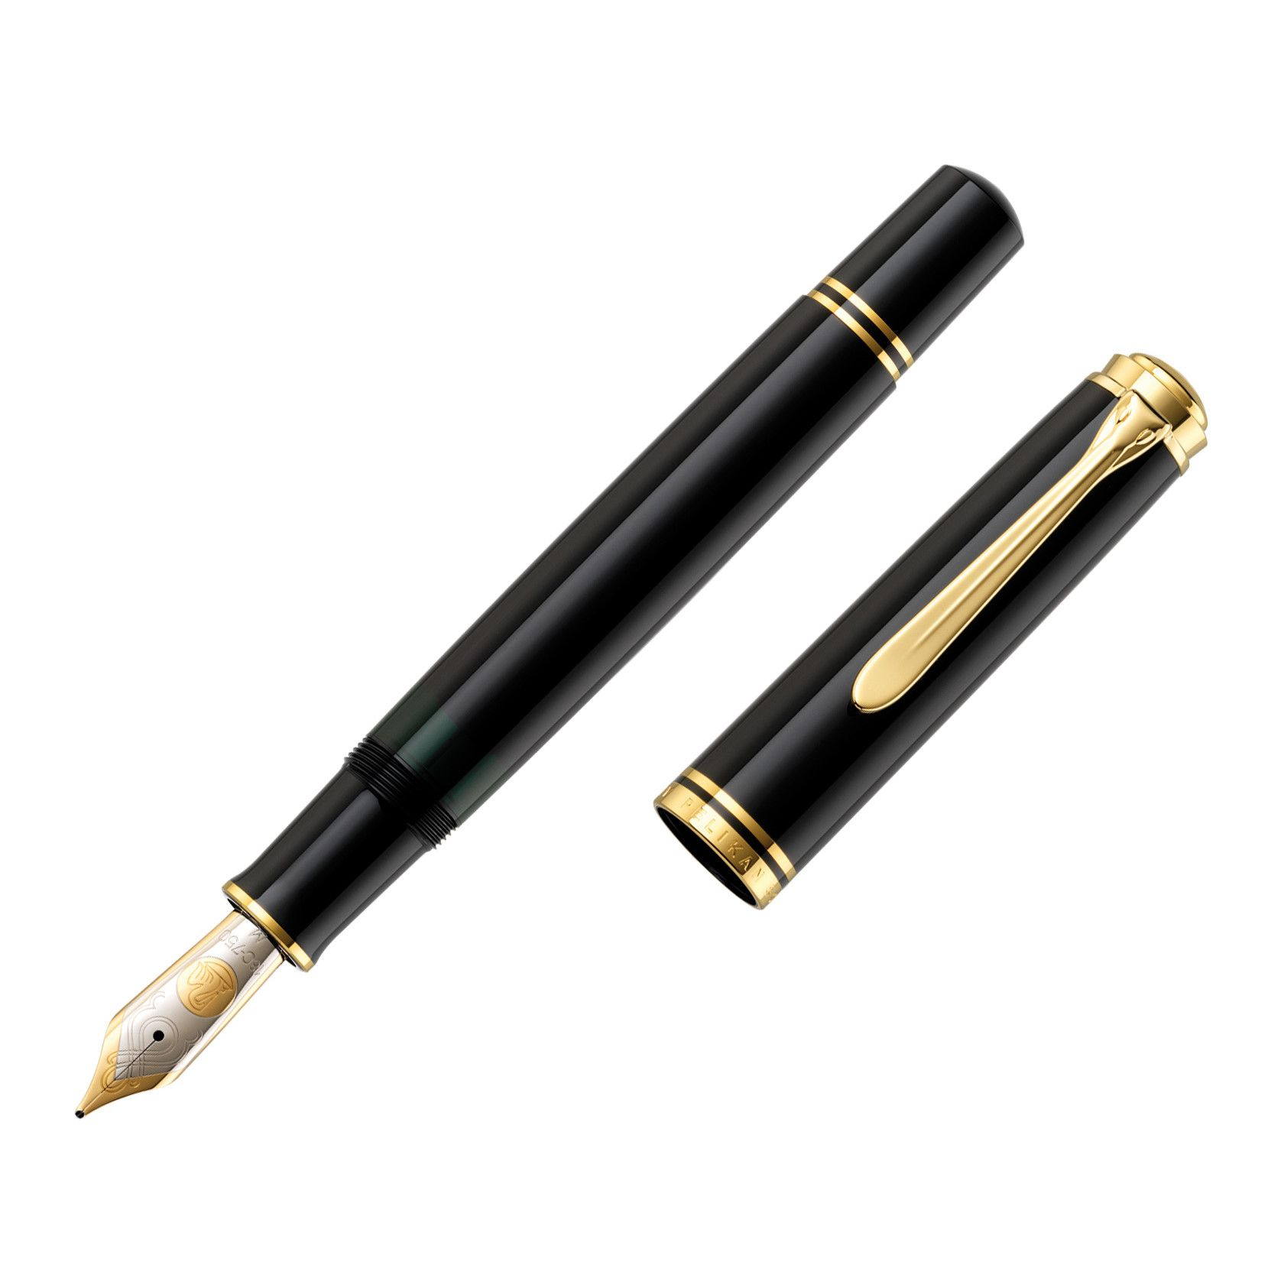
7.

